Slide 1
Lightning Talk 6 – Contextualization/Design Check-In
sdmay25-16

Slide 2
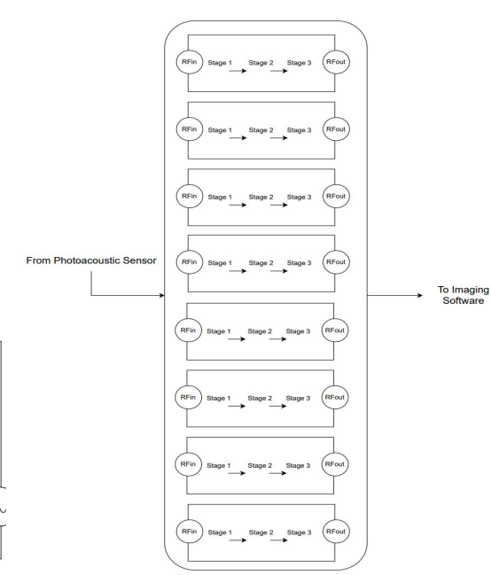
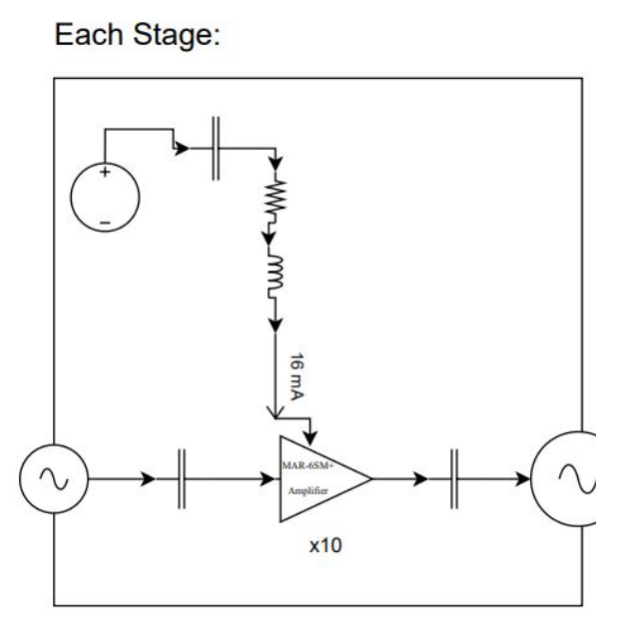
Project Overview
Problem Statement: Design and build an 8/16 channel amplifier with little noise to boost ultrasound signals received for the acoustic imaging system.
Constraints:
Low noise
Low input impedance
Bandpass filtering: 10k-1M
Small size (< 5x5 cm)
ESD protection

Slide 3
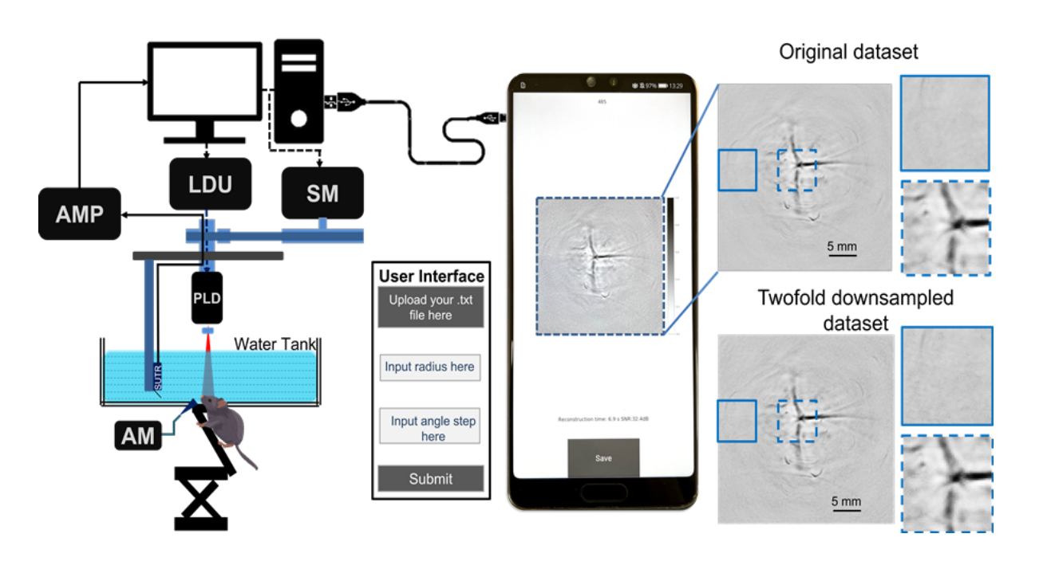
Human Suitability
Technical performance is the priority
Low noise
High gain (1000-10000 V/V)
Modularity is second most important feature
Capability of functioning in 8 channel and 16 channel configurations
Low maintenance
Easy setup

Slide 4
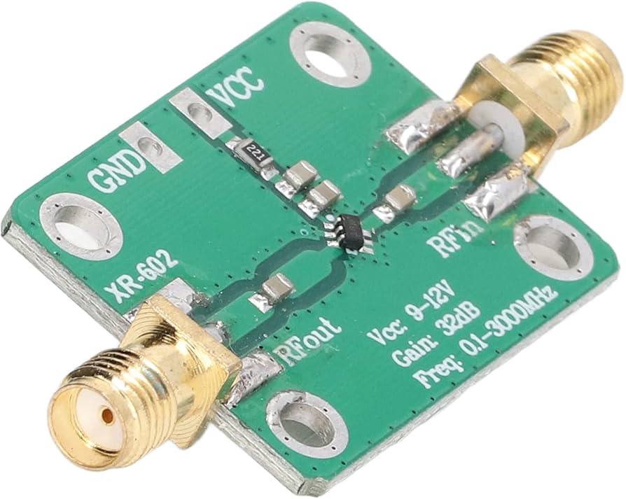
Economic Suitability
Similar mass-produced products exist but do not fit our needs as well
Gain, Bandwidth, and power supply can be selected by us to perfectly match our application
There is currently only 1 setup where the amplifier can be used so the required quantity is low
Improved performance is worth slightly higher cost to our clients, especially considering the required quantity is low.

Slide 5
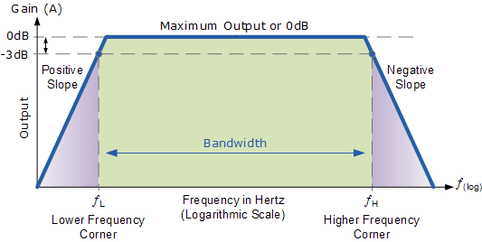
Technical Suitability
Many parameters affected by design:
Gain
Bandwidth
Power Supply
Noise
Distortion
Required knowledge:
EM shielding
Filters
High frequency circuit design
Reverse engineering of the existing prototype is also necessary

Slide 6
Conclusions
Functionality most important aspect to users
Modularity is the second most important
Low quantity and a highly specialized product outweigh increased costs
Knowledge of many complex topics in necessary
Design process is similar to common engineering processes

